Slide 1


O vício da nicotina

Slide 2






Tecnologías utilizadas

Slide 3
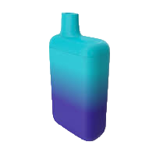


Slide 4


Paginas de login e cadastro

Slide 5
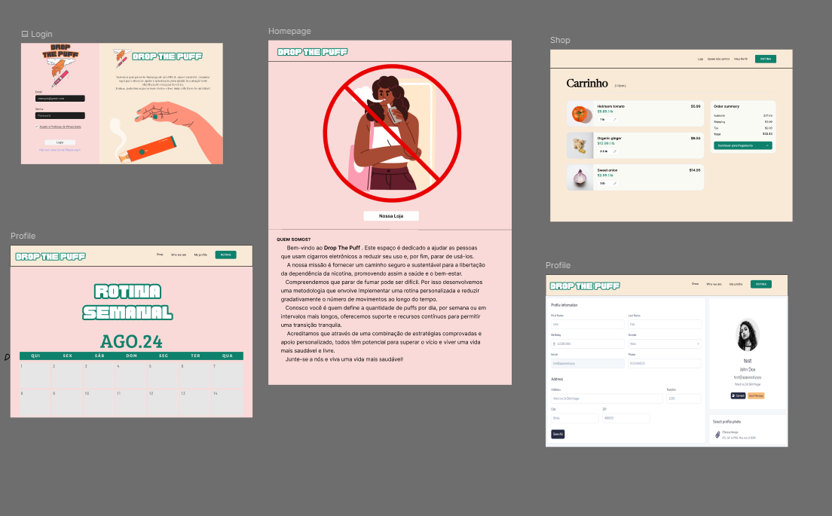

Slide 6
You can divide the content
Mercury
Venus
Mercury is the closest planet to the Sun and the smallest one in the Solar System—it’s only a bit larger than the Moon. This planet’s name has nothing to do with the liquid metal, since Mercury was named after the Roman messenger god
Venus has a beautiful name and is the second planet from the Sun. It’s terribly hot—even hotter than Mercury—and its atmosphere is extremely poisonous. It’s the second-brightest natural object in the night sky after the Moon

Slide 7
Here are three important ideas
Jupiter
Venus
Saturn
Jupiter is a gas giant and the biggest planet in the Solar System. It's the fourth-brightest object in the night sky and was named after the Roman god of the skies
Venus has a beautiful name and is the second planet from the Sun. It’s terribly hot and its atmosphere is poisonous. It’s the second-brightest natural object in the night sky
Saturn is a gas giant and has several rings. This planet is composed mostly of hydrogen and helium. It’s the sixth planet from the Sun and was named after a Roman god too

Slide 8
Divide the content into four ideas
Mars
Venus
Despite being red, Mars is actually a cold place. It’s full of iron oxide dust, which gives the planet its reddish cast, and it’s made of basalt
Venus has a beautiful name and is the second planet from the Sun. It’s terribly hot and its atmosphere is extremely poisonous
Jupiter
Saturn
Jupiter is a gas giant and the biggest planet in the Solar System. It’s the fourth-brightest object in the night sky and was named after a god
Saturn is a gas giant and has several rings. It’s composed mostly of hydrogen and helium. It’s the sixth planet from the Sun

